Slide 1


Slide 2

Sharps Awareness &
Biological Hazards

Slide 3

Welcome
Introductions
Housekeeping
    Fire alarm
    Toilets
    First Aid
    Phones

Slide 4
Section 1: Sharps Awareness

Slide 5

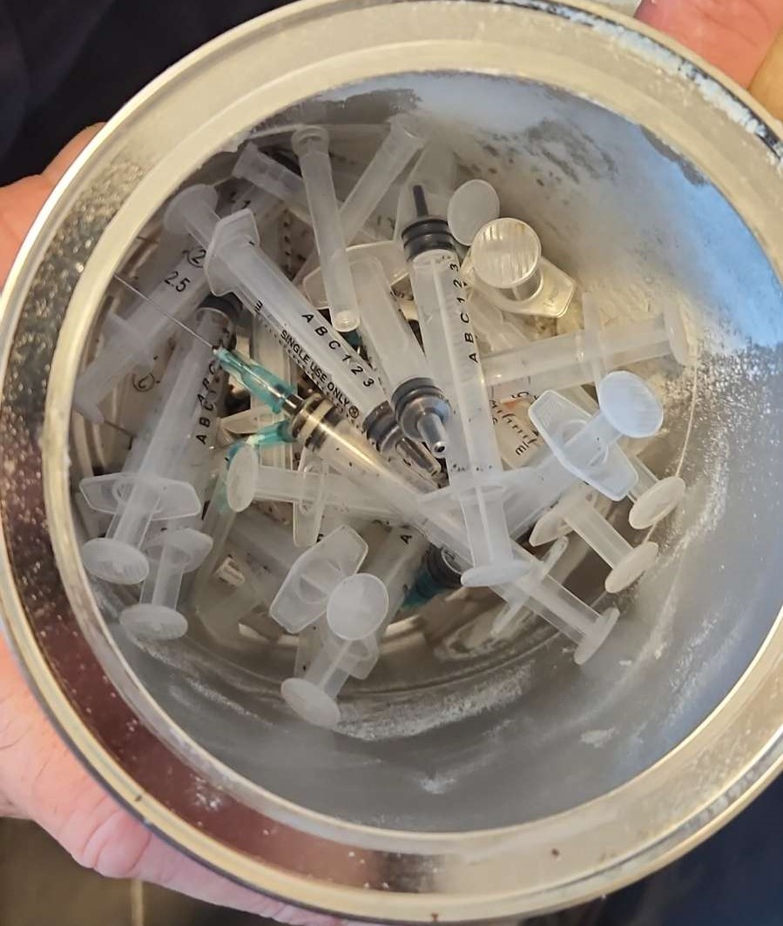
Sharps – definition
Sharps include:
hypodermic needles
scalpels
stitch cutters
glass ampoules
any other sharp instrument that can puncture the skin
* Discarded needles are of particular concern

Slide 6
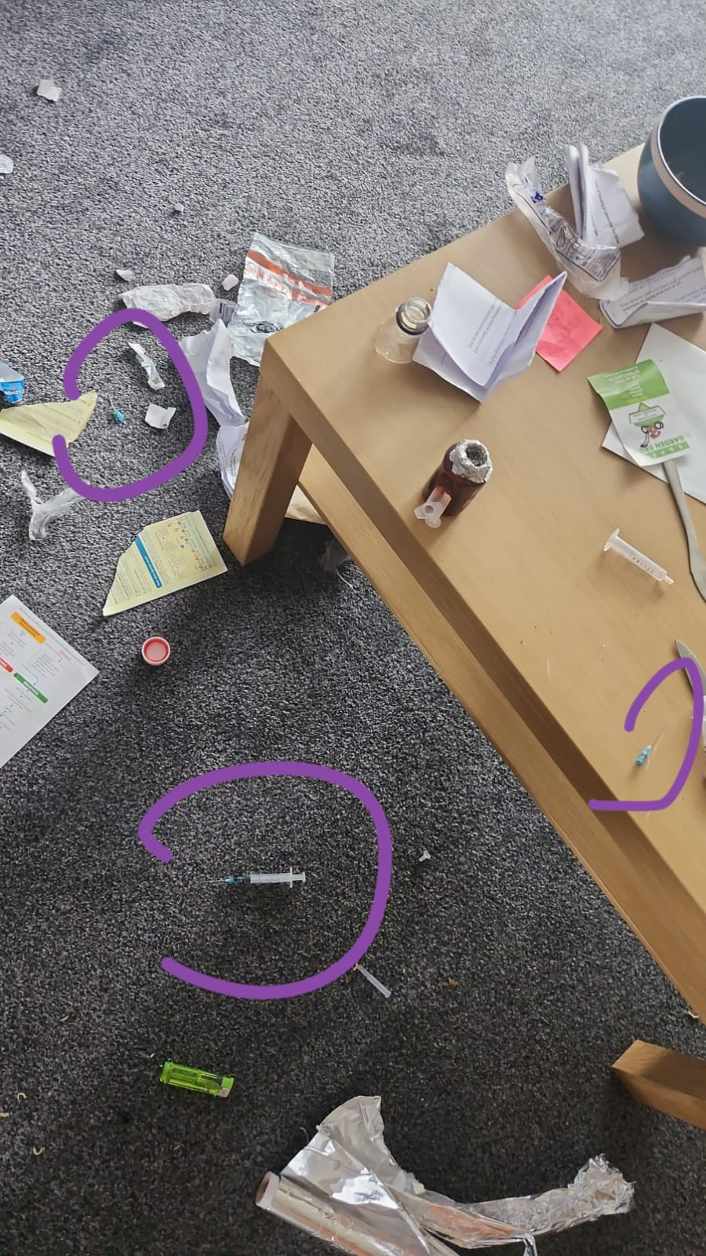
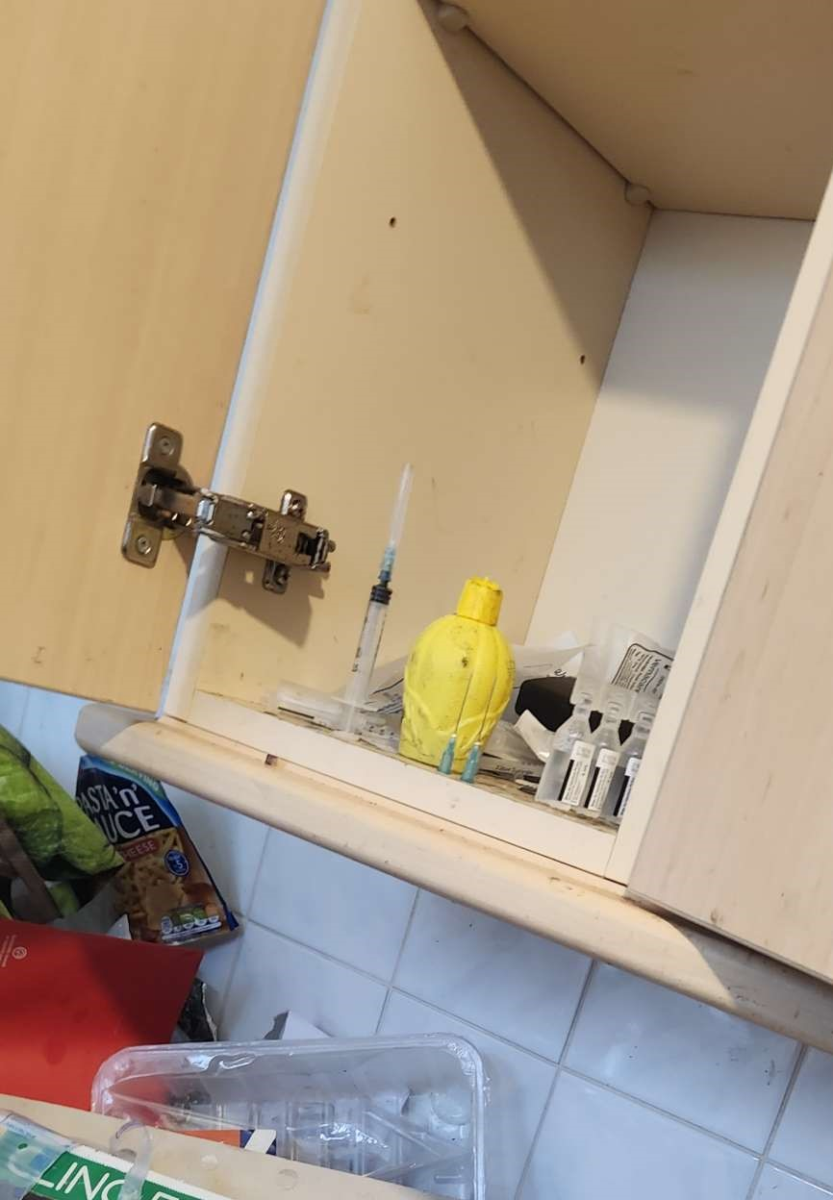
Discarded needles are of particular concern…
Never put your hands into an area you cannot see and where there is a possible risk

Slide 7
Where needles may be found
Outdoors:
  Public toilets
  Parks
  Play areas
  Bins / refuse sacks
  Sewers / gullies
  In grass cutting machinery
  Shrubs & undergrowth

Slide 8
Where needles may be found
In properties:
On top of / in cupboards
Toilet bends, cisterns, pipes and drains
Bins / refuse sacks
On top of doors and windows
Behind radiators
In switches, boiler casings etc.
Taped to banisters
In soft furnishings, including sofas

Slide 9
Sharps used during Health Checks
As part of our Community Health Check programme, staff may carry out cholesterol and glucose testing on members of the public.
This process involves the collection of a blood sample and extreme care must be taken when carrying this out.
Only trained staff should perform this function, and they must refer to the Health Check Handbook for guidance in advance.

Slide 10
If you are injured by a needle
If a needle punctures the skin:
Immediately encourage bleeding, do not suck blood from the wound
Thoroughly wash with soap and water, do not scrub
Dry and apply a waterproof dressing
Report the incident to your line manager
Attend A&E
Report the incident on the SHE system

Slide 11
Additional information
Read and refer to our Infection Control in the Workplace H&S Standards and our Sharps Disposal Protocol, both available on the intranet
If you are likely to come in contact with biological or chemical substances whilst at work which may cause harm to health and/or environment. e.g. blood, bodily fluids or animal waste, please stay for Section 2: Biological Hazards

Slide 12

Any questions?

Slide 13
Section 2: Biological Hazards

Slide 14
Biohazards – definition
Biological or chemical substances which may cause harm to health and/or the environment:
  Blood
  Bodily fluids
  Animal waste

Slide 15
Coming into contact with Biohazards
Working with people who may have infections, illnesses
or diseases
Cleaning up bodily fluids
Handling waste materials
Working where needles may have been discarded
Working with animals, including animal waste
Working near water e.g. drains, culverts, rivers

Slide 16
Leptospirosis (BA)
Also known as Weil’s Disease
    Waterborne infection
    Associated with rats and cattle urine
    Enters the body through cuts, scratches and mucous membranes
    Causes flu-like symptoms – headache, fever, vomiting
    In severe cases can lead to meningitis and kidney failure

Slide 17
Psittacosis (BA)
Also known as ornithosis:
  Associated with birds – dried droppings, respiratory secretions or feather dust
  Enters the body through inhalation
  Causes flu like symptoms – headache, fever, muscle aches
  Can lead to severe pneumonia

Slide 18
Hepatitis B (BBV)
  Virus that infects the liver
  Spreads through blood and body fluids
  Symptoms develop 2-3 months after exposure
    Flu like symptoms – fever and general aches and pains
    Vomiting, diarrhoea, abdominal pain
    Jaundice
    Can be asymptomatic and clear up without treatment
    Emergency treatment can prevent infection

Slide 19
Hepatitis C (BBV)
Virus that infects the liver
Spread through contact with infected blood
If left untreated can cause severe liver damage
Symptoms often don’t appear until liver has been significantly damaged:
    flu-like symptoms
    fatigue
    gastrointestinal symptoms
Early treatment can reduce risk, but does not give immunity to future exposure

Slide 20
Hepatitis D (BBV)
Only affects people already infected with Hepatitis B
Spread through blood-to-blood contact
Long term infection can increase risk of cirrhosis and liver cancer
Not common in the UK

Slide 21
Human Immunodeficiency Virus (HIV)
Virus that damages cells in immune system, can lead to AIDS
No cure, but treatment & daily medication can help those infected to live a long, healthy life
Flu-like illness for 2 weeks then often no symptoms, but continues to damage immune system
Can spread in bodily fluids – not sweat, urine or saliva
Emergency treatment within 24-72 hours can prevent infection

Slide 22
Transmission routes
Blood borne viruses can enter the body through:
  puncture wounds
  mucous membranes (eyes, nose, mouth)
  open cuts
  broken skin
Must cover any cuts with waterproof plaster
Wear PPE to protect mucous membranes

Slide 23
Any questions?

